Slide 1
Recommendations
*For informational purposes only. Delete slides 1-5 after reading.
The first five slides (1-5) are meant to be an introduction to color accessibility and appropriate usage. These five slides can be deleted.
The remaining slides (2-26) are examples on how the templates can be used and include alternate versions (e.g., Closing Slides). Any slides that aren’t used should be deleted.
All slide design templates are available through the Layout menu.
We have set up our brand colors as the theme colors for the template. Please use our brand colors exclusively in your presentation.
If the presentation will be made available for view or download online, the creator should ensure the presentation meets accessibility standards. Please refer to Microsoft’s guide on how to make your presentation accessible by clicking here. Also refer to slide 2-5 for more information.
If you have any questions regarding the visual identity of Syracuse University, please visit syracuse.edu/brand.

Slide 2
Accessibility
*For informational purposes only. Delete slides 1-5 after reading.
At Syracuse University, we have and always will be actively shaping an education and environment that’s innovative, impactful and inclusive.
When designing and developing our expressions and experiences, we consider the distinct perspectives and needs of all. The following slides show approved color combinations that meet our accessibility standards (WCAG 2.0 AA). When choosing typography and background colors, always promote visibility and legibility by ensuring sufficient contrast. Font sizes and weights also play a crucial role, which is why we’ve provided minimums for each color combination. For presentations, we recommend making sure that your text is sufficiently large so that the people in the back of the room can read it.
To test your design’s accessibility, we suggest proofing color pairs (text color versus background color) using a contrast calculator. A contrast ratio of 4.5:1 (Level AA of WCAG 2.0) is required for text.

Slide 3
Color Palette
*For informational purposes only. Delete slides 1-5 after reading.
Primary Colors
Syracuse University Orange Screen HEX #F76900 RGB 247/105/0 | White Screen HEX #FFFFFF RGB 255/255/255 | Primary Blue Screen HEX #000E54 RGB 0/14/84
Secondary Colors
Medium Orange Screen HEX #FF431B RGB 255/67/27 | Light Orange Screen HEX #FF8E00 RGB 255/142/0 | Medium Blue Screen HEX #203299 RGB 32/50/153 | Light Blue Screen HEX #2B72D7 RGB 43/114/215
Black Screen HEX #000000 RGB 0/0/0 | Medium Gray Screen HEX #707780 RGB 112/119/128 | Light Gray Screen HEX #ADB3B8 RGB 173/179/184

Slide 4
Color Accessibility
*For informational purposes only. Delete slides 1-5 after reading.
Primary Colors – Large web text sizing
(WCAG 2.0 AA defines large web text as 18.66px or larger and bold weight, or 24px or larger.
Go ahead.
Go ahead.
Text: #F76900
Background: #FFFFFF
Text: #FFFFFF
Background: #F76900

Slide 5
Color Accessibility (Continued)
*For informational purposes only. Delete slides 1-5 after reading.
Primary Colors – Normal web text sizing
(WCAG 2.0 AA defines normal web text as 18.66px or smaller).
Secondary Colors – Normal web text sizing
(WCAG 2.0 AA defines normal web text as 18.66px or smaller).
Go ahead.
Text: #000E54
Background: #FFFFFF
Go ahead.
Text: #000E54
Background: #FF8E00
Go ahead.
Text: #FFFFFF
Background: #2B72D7
Go ahead.
Text: #000E54
Background: #F76900
Go ahead.
Text: #FF8E00
Background: #000E54
Go ahead.
Text: #FFFFFF
Background: #203299
Go ahead.
Text: #FFFFFF
Background: #000E54
Go ahead.
Text: #FF431B
Background: #000E54
Go ahead.
Text: #000E54
Background: #FF431B
Go ahead.
Text: #F76900
Background: #000E54

Slide 6
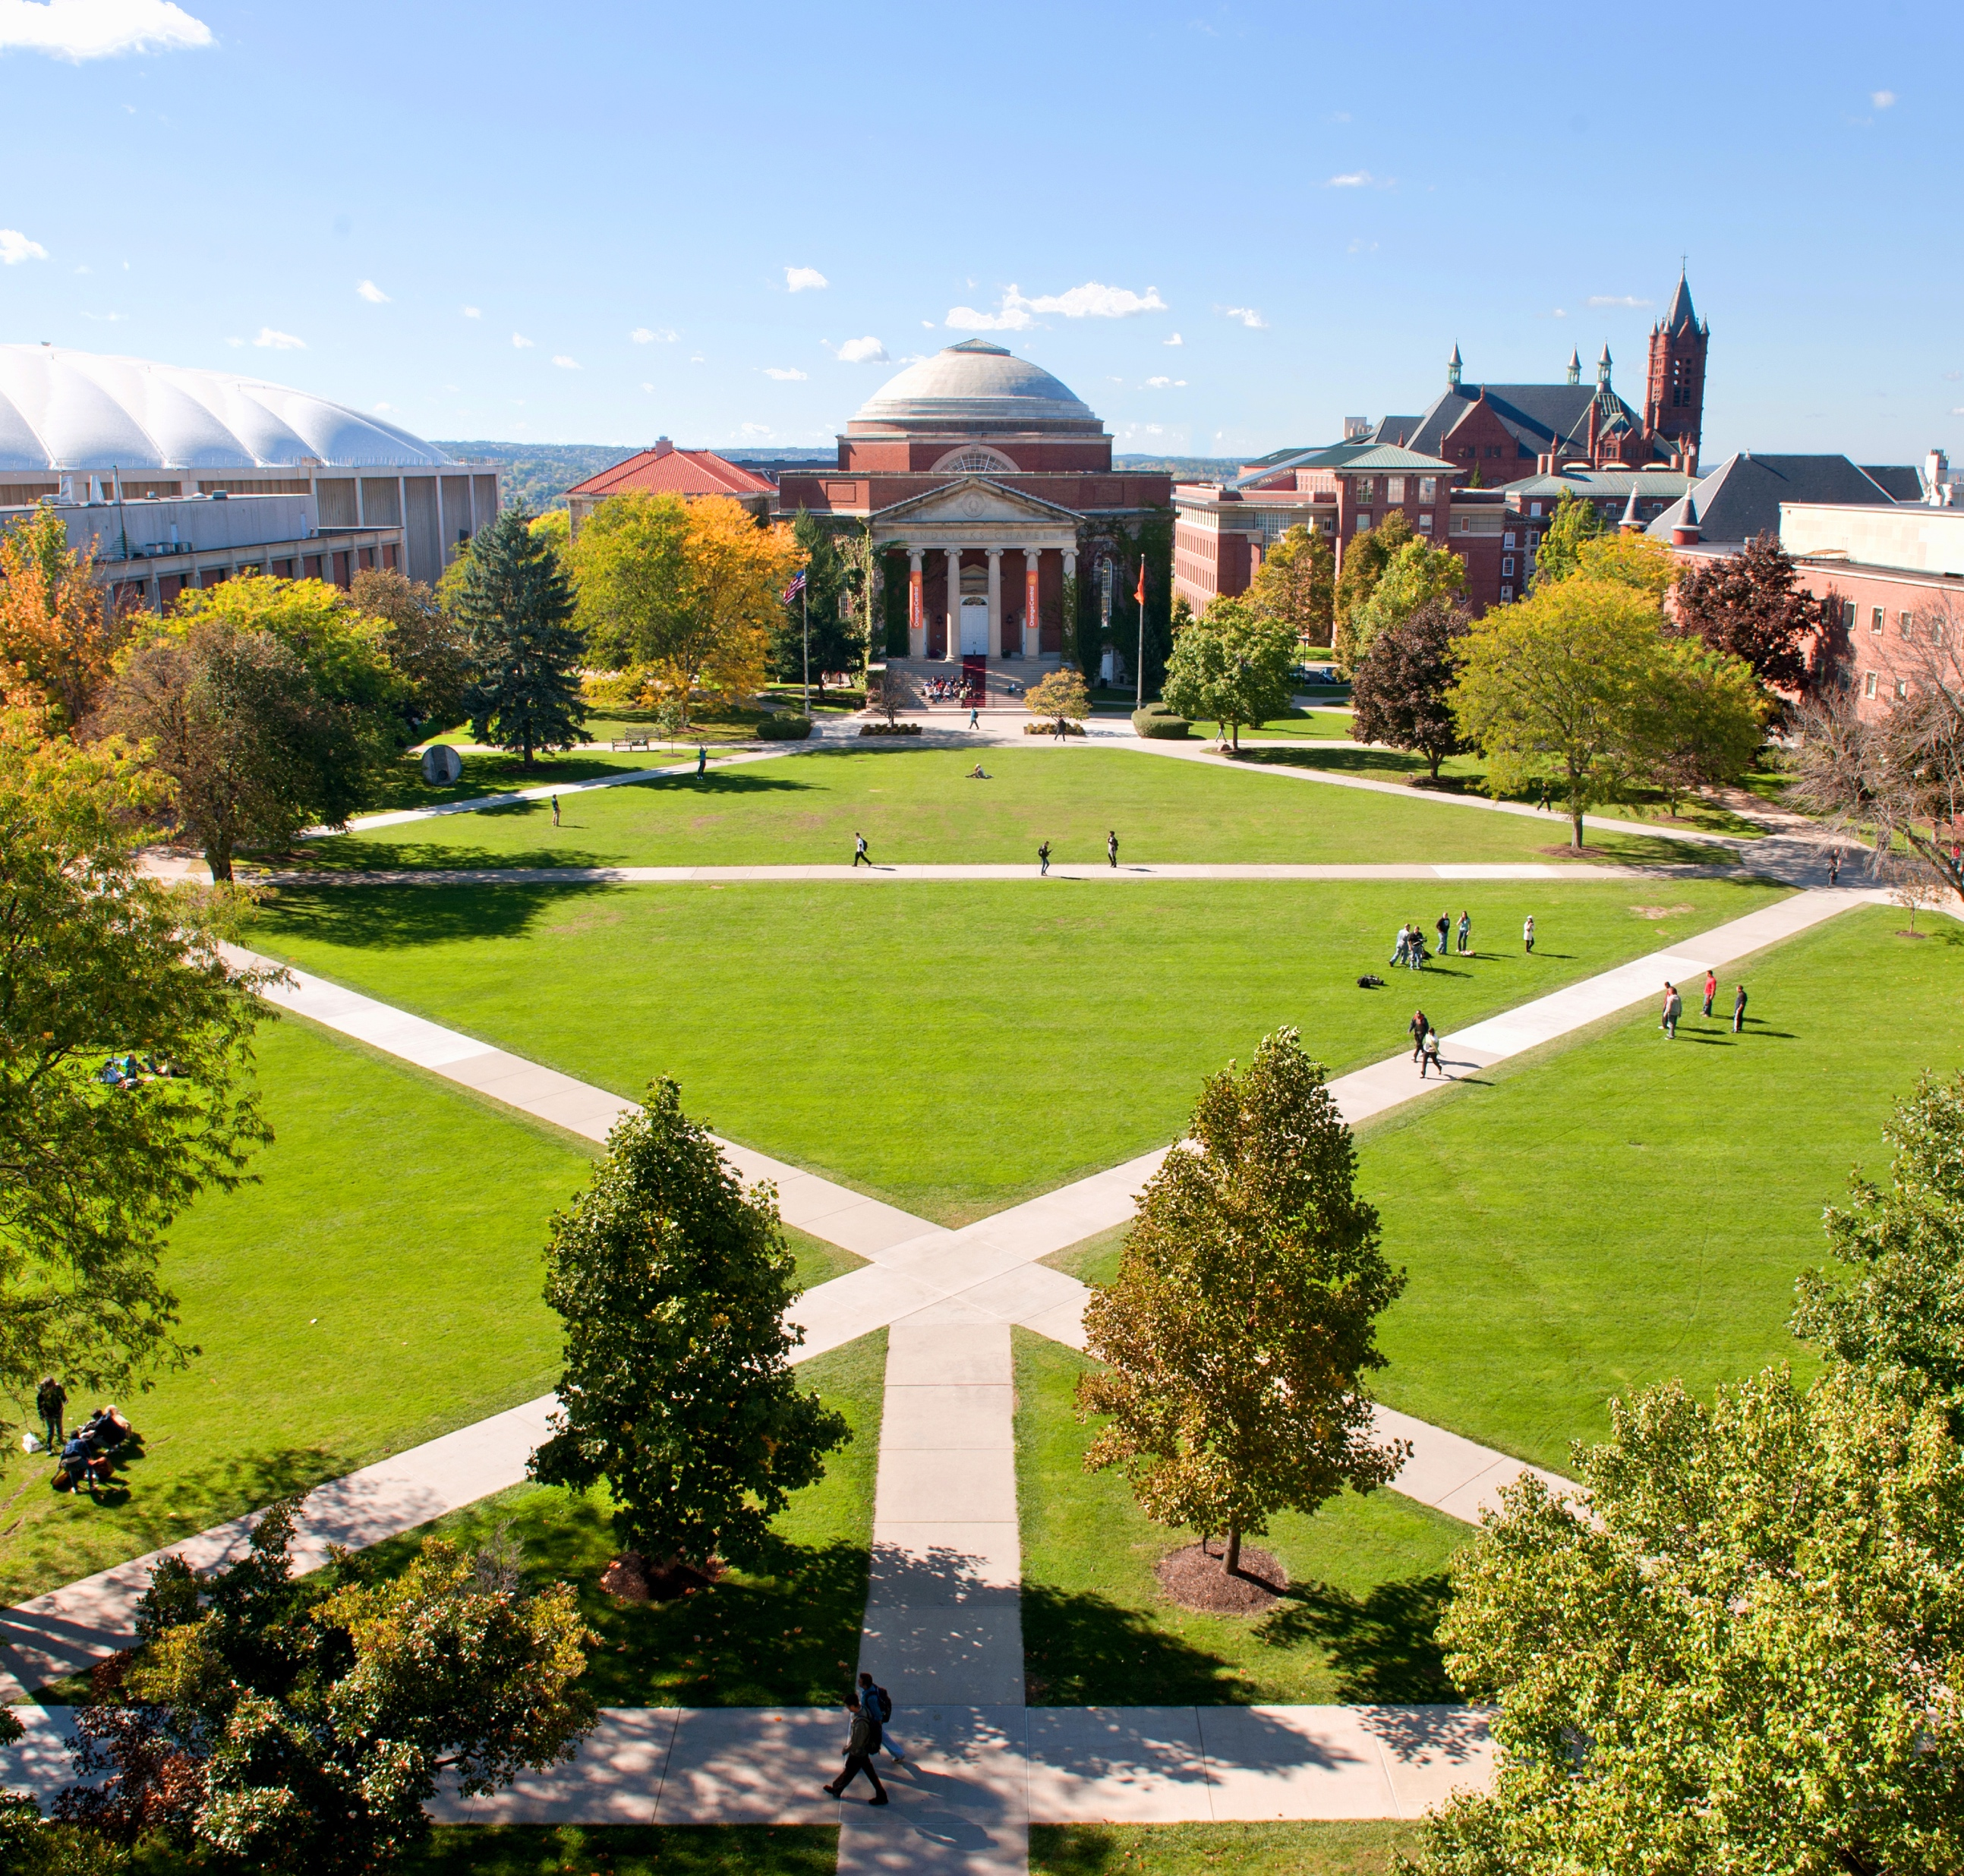
N-Body Problem
Shu Li

Slide 7
Background
Natural sciences: physical bodies or elementary particles that affect each other through physical forces stemming from gravity or electromagnetic field.
instantaneous change in position, velocity, acceleration, and momentum can be computed based on positions and intrinsic properties such as mass or charge of all other particles in the system.
In one iteration: object properties updates are independent of each other. The parallel implementation typically involves partitioning the objects between the PEs so that their properties can be updated concurrently.

Slide 8
Assumptions
Bullet #1
Bullet #2
Bullet #3

Slide 9
QuadTree

Slide 10
Title Goes Here (Example of Bar Graph in a Text Only Slide)

Slide 11
Title Goes Here (Example of a Pie Chart in a Text Only Slide)

Slide 12
Title Goes Here (Example of a Table Slide)
Column 1 | Column 2 | Column 3 | Column 4 | Column 5
Data point 1 | Data point 5 | Data point 9 | Data point 13 | Data point 17
Data point 2 | Data point 6 | Data point 10 | Data point 14 | Data point 18
Data point 3 | Data point 7 | Data point 11 | Data point 15 | Data point 19
Data point 4 | Data point 8 | Data point 12 | Data point 16 | Data point 20

Slide 13

Title Goes Here (Example of a Picture Only Slide)

Slide 14
Single Heading or Impact Statement Here (Example of Title Only Slide)

Slide 15

Section Title Here
Version two (with included image)

Slide 16
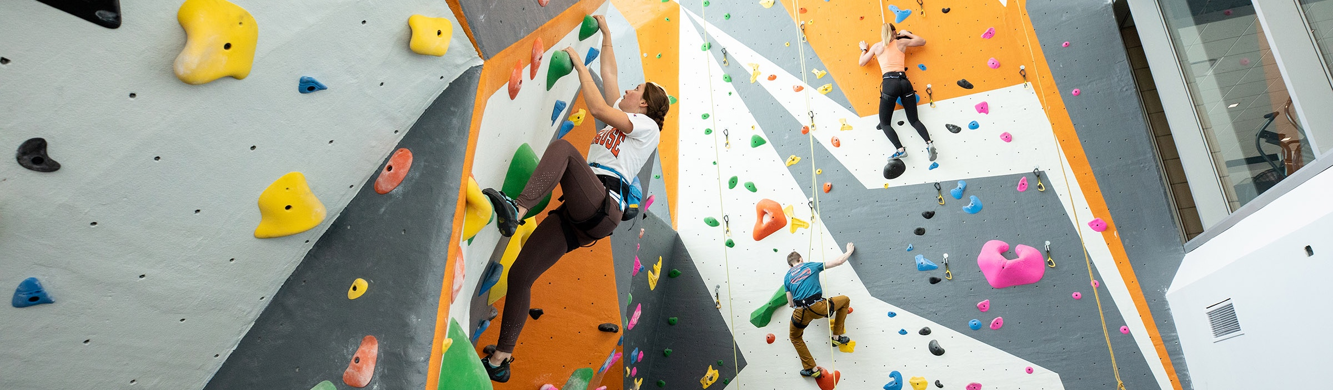
Section Title Here
Version two (with added image)

Slide 17
Closing Text
Your Name
Your Title
Your contact information

